Slide 1



Slide 2
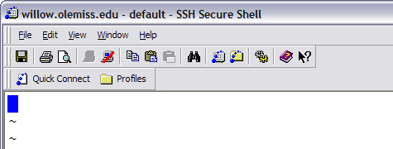
Starting Vi
  Opening an existing file
        vi filename
  Creating a new file
        vi filename
In your workshop directory, create a new file called mysong
vi mysong

Slide 3
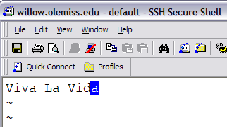
Vi Modes of Operation
  Command Mode
    Allows the entry of commands to manipulate text
    Default mode when vi starts
    Use Escape key to move into command mode
  Insert Mode and
    Puts anything you type into the current file
    To get into insert mode, commands are
    a (append) and i (insert)
1. Use the i command to move into insert mode (Press i key).
2. Attempt to type in the title of your favorite song.
3. Use the Esc key to move to command mode.

Slide 4

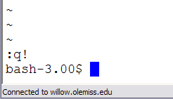
Exiting the Vi Editor
  :q Quit the editor
  :q! Quit without saving changes to the file
Use the Esc key to make sure you are in command mode.
Use the :q command to try to quit vi
Use the :q! command to force quit without saving (Enter :q! ).

Slide 5

Saving Changes in vi
  :wq Write/save changes and quite
  :w Write/Save changes, but don’t quit
Type vi mysong to re-edit your song file.
Use the i command to move into insert mode (Press i key).
Retype the title of your favorite song.
Use the Esc key to move to command mode.
Use the :w command to write/save your edits to file.
Use the i command to enter insert mode (Enter i ).
Type Title: somewhere on the line with the song title.
Use the Esc key to move to command mode.
Use the :wq command to save and quit vi .

Slide 6
Vi Editor
How to type commands in command mode
  [count] command [where]
  count : Its a number
  where : Specifies how many lines or how much of the document the command affects. It can also be any command that moves the cursor.

Slide 7

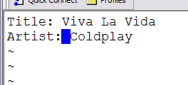
Moving the cursor in vi
  h key move cursor to the left one position
  l key move cursor right one position
  j key move cursor down one line
  k key move cursor up one line
Type vi mysong to re-edit your song file.
Use the l command several times to move cursor to the far right
Use the a command to move into append mode (Press a key).
Use the Enter key to start a new line of text.
Type: Artist: and then the name of the artist
Use the Esc key to move to command mode .
Practice moving cursor up, down, left,
and right with h,l,j,k keys.
.

Slide 8
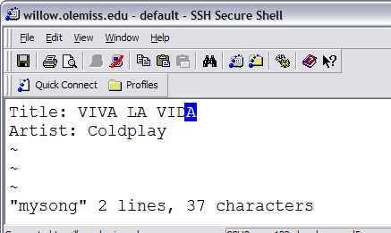
Simple vi editing commands
  r replace one character under the cursor
  x delete 1 character under the cursor.
  2x delete 2 characters (3x, etc.)
  u undo the last change to the file
Use the Esc key to make sure
you are still in command mode.
Reposition your cursor and
use the a, l, r and x commands
to repair any typos in your
title and artist, and change
the title to ALL CAPS
Use the :w command to save your changes.

Slide 9
Cutting text in Vi
    d^
    Deletes from current cursor position to the beginning of the line
    d$
    Deletes from current cursor position to the
    end of the line
    Dw
    Deletes from current cursor position to the
    end of the word
    dd
    Deletes one line from current cursor position. Specify count to delete many lines.

Slide 10
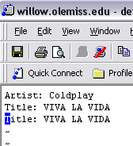
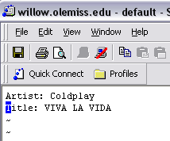
Cutting & Yanking Text in Vi
    dd Delete (cut) 1 line from current cursor position
    2dd Delete (cut) 2 lines (3dd to cut 2 lines, etc.)
    p paste lines below current line
Move cursor to top line and type dd to cut the title line
Use the p command to paste the title line below the artist line
Use the p command to paste it again.

Slide 11
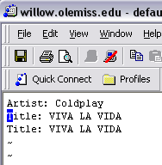
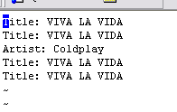
Cutting & Yanking Text in Vi
    yy yank (copy) a single line
    2yy yank (copy) 2 lines (3yy to copy 3 lines, etc.)
    P paste lines before current line
Move cursor to first of the 2 title lines and
type 2yy to yank/copy 2 lines
Move cursor to the first line, then use the capital P command to paste the two yanked links above the artist

Slide 12
Vi Editor
To go to a specific line in the file
  :linenumber
Go to the 3rd line by typing :3
Go to the 1st line by typing :1
Go to the last line by typing G

Slide 13
Vi string/search
/[pattern] search forward for the pattern
?[pattern] search backward for the pattern
n search for the next instance of a string
Search forward for the next line containing the string Title by typing /Title
Search forward for the next instance of Title by typing n
Search backward for the most recent instance of Title by
typing ?Title
Search backward for the next most recent instance of Title by typing n

Slide 14
More commands
    yl
    yank a single character. Specify count to yank more characters
    yw
    yank a single word. Specify count to yank more words
    d^
    Deletes from current cursor position to the beginning of the line
    d$
    Deletes from current cursor position to the
    end of the line
    Dw
    Deletes from current cursor position to the
    end of the word

Slide 15
Practice Editing with vi
Take 5 minutes to practice what you’ve learned by entering as many of the lyrics to the song as you can.
Use yank and paste to repeat chorus lines.
Use :w to write changes every 30 seconds.
Have one title line at line 1.
Have one artist line at line 2.
Save file and exit vi when finished or time expires.

